Slide 1


Slide 2
Overview of LA:
Strong history of anti-labor policies and activities;
Today home to one of the most vigorous and effective labor/social justice movements in the country;
Spatial strategy based on coalition building among labor, faith-based, community organizations, and universities—
  How does this expand the basic Alinsky model?
Goals of LA Social Justice Model:
  Raise wages and improve workplace conditions;
  Enhance tenants rights & expand affordable housing;
  Improve schools;
  Institutionalize environmental and racial justice;
  Improve basic public services.

Slide 3
Importance of the LA Experience:
Change: Exemplifies National Patterns of Change: Neoliberal Globalization, Economic Restructuring and Growing Inequality.
Proactive Organizing & Advocacy Model: Independent Political Organizations based in the Community—not Political Party proxies—Co-learning among Labor, Faith & Community Leaders, Researchers & Students (universities)—expands the basic Alinsky model.
  UFW’s community unionism—alliances among labor & non-labor groups to achieve common goals; increased the sensitivity to community issues where workers live;
  Revitalized the regional labor movement;
  Spatial & Strategic Organizing focused on rooted industries and based on “development with justice”;
  Emphasized the importance of research & evidence based alternative policies & media.
  To reinvigorate Civil Society & rebuild communities from below.

Slide 4
Why LA?
  Why did a new Labor-Community Justice Movement emerge in LA?

Slide 5
Context: Post-1970s Shift in LA
Neoliberal Globalization & Deindustrialization-Reindustrialization:
  Shift from the Union & Middle-class based Fordist mass production-mass consumption regulated manufacturing system. 1940s-1970s-late 1980s in LA; Why?)
  To
  Polarized-Hourglass deregulated and flexible just-in-time information intensive system. (post-1908s), i.e., knowledge-based) economy.
Effects:
  Population Decentralization and Recentralization
  Job Loss/Gains: shift to bifurcated service and industrial sectors
  Intensification of social polarization & wealth and income inequality

Slide 6
Demographics:
Demographic Shifts: decentralization & recentralization based on increasing diversity.
White Flight and inner-city de-urbanization:
  LA: From 80% White to roughly 27% (2013).
  Long Beach: 95% White (1960); 25% (2010)
LA Urbanization of Surbia: Creation of “outer-cities”
  Orange County
  San Fernando Valley
  Inland Empire
Re-urbanization based on:
  In-migration from Latin America and Asia—without increases in housing stock—increasing density.
Shifting and Complex racial and ethnic patterns: Beyond Black-White divisions.

Slide 7
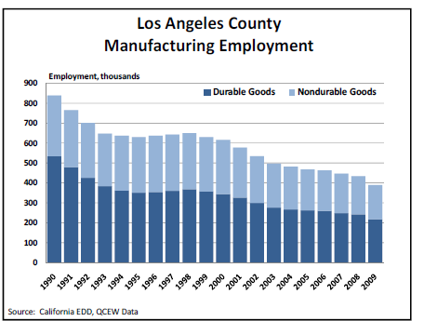
Deepening Inequalities: Jobs
From 1996 to 2006, Los Angeles County lost more than 170,000 manufacturing jobs. Since 2007, LA lost 111,000 manufacturing jobs (average $68,000/yr); gained 86,000 food service jobs (average $22,000/yr); 68,000 social assistance jobs (averaging $18,000/yr). LA remains the largest manufacturing center in the US (based on employment in high tech—electronic products; and low tech—apparel—4th largest sector).

Slide 8
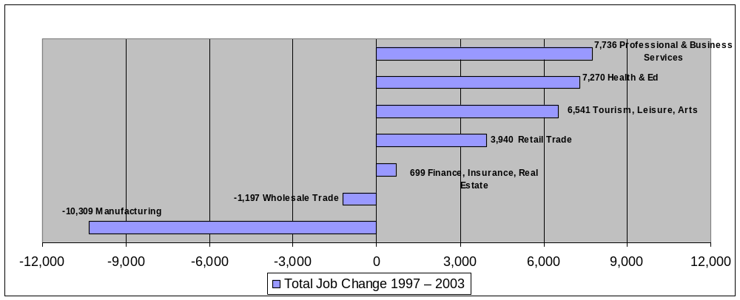
Long Beach: Occupational Shifts
  Top three economic sectors and average pay (2016)
  # 1 Educational Services : $53,000
  #2 Hospitals, Physicians: $63,000
  #3 Restaurants and Bars/Hospitality & Tourism: $18,000
  #7 Durable Manufacturing: $96,000

Slide 9
Inequalities:
Growing Inequality: Increased concentration of working poor & and growing income gap; largest since the 1920s.
Income:
  Top 5% of US families saw a 75% increase in real income and the bottom 20% saw a 12% decrease in real income between 1979 and 2012.
  A top 5% LA household income averages $218,000; 12.5 times more than a bottom 20% household’s income (2012-2103).
  A top 5% LB household income averages of $195,675, 10 times more than a bottom 20% household income (2012-2103).
Working Poor:
  The 2011 average hourly wage in real dollars was 3.6% above its peak in 1972.
  The top two occupations projected to grow the most between now and 2022 (personal care and home health aids) median annual wage of $20,365 (2012$).
  40% defined as working poor in LA & 42% in LB; high % of minority workers.

Slide 10
Reaction I:
1) Urban Rage & Community Destruction (also in LB):
  Watts Uprising 1965 & East LA 1966-70:
    South LA: reaction to continued high levels of marginalization & high unemployment; CA passed Proposition 14, which blocked the fair housing portion of the 1968 Civil Rights Act (official unemployment for black males, 3 times the state rate).
    East LA: reaction to low levels of school integration, poor education (60% drop out rate), inequality & discrimination.
  Justice Uprising 1992:
    Multicultural reaction to continued racial injustices exacerbated by the distortions caused by the globalized “New Economy.”
    Recognition that the government couldn’t be counted on to help resolve the deeply embedded community problems.
    Based on demands for economic & social justice.
http://documents.latimes.com/aug-16-1965-rioting-shifts-long-beach /
https://www.presstelegram.com/2017/04/23/long-beach-reflects-on-la-riots-our-situation-was-as-bad-as-las/

Slide 11
Reaction II:
2) Urban Organizing and Community Rebuilding:
Right to the City: demands for inclusion in the decision-making process
Greater control over how the spaces in which we live are created; (Right to the City = social justice)
Multiracial Justice-Based coalitions reweaving the fabric of the city:
  Black and brown students organized around school reform.
  Immigrant Korean and Latino workers together to force restaurant and hotel employers to the bargaining table.
  A revitalized immigrant led-labor movement:
    Unionizing largely African American security guard workforce.
    Unionizing home care workers.
    Unionizing Immigrant janitors.

Slide 12
Conditions for Justice-Based Coalitions:
  Deepening community devastation due to restructuring.
  Failure of existing organizing strategies to halt community devastation—e.g., CDCs; the CSPC.
  Failure of traditional party politics & post-1980 neoliberal governments in Washington to help.
  Rampant violations of basic workplace and health regulations.
  Recognition that community problems stemmed from one source: Neoliberal Globalization.

Slide 13
LAANE:
LAANE: A major Policy Advocacy Organization founded in 1993 brought together many of the Justice-based Organizations: Labor, Community organizations, and other advocacy groups, e.g., SAJE—Strategic Action for a Just Economy, CLUE, UniteHere, CSPC, J4J activists
Mission: to build an economy based on good jobs, thriving communities and a healthy environment.
Context: Rooted Tourist/Hospitality Sector vs. Footloose capital.
Innovative strategies: Building relationships among place-based employers, labor and community orgs to rebuild communities:
  Living Wage:
  CBAs:

Slide 14


Slide 15
Living Wage: Definition:
Basic and narrow:
  That those working full time year-round should be paid enough to support a family at least at the poverty line.
Broad:
  Those working full time year-round should be paid enough to provide a level of affluence to allow the life of a civilized life according to the standards prevailing in the society.
This broader conceptualization is based on the fundamental human right to have the ability—or capabilities—to support a family, to maintain self-respect, and to have the means and the leisure to participate in the civic life of the community.

Slide 16
A Response designed to halt the race to the bottom: reverse the downward trends in real wages, and upward trends in inequality; and shift power and democratic control back to the community.
Timing: Arrived on the scene in the late 1980s but is really a new formulation of an old concept. The term was used extensively in the early 20th century debates over the minimum wage, but the concept of a living wage has no necessary relationship to the minimum wage.
Goal: to improve human wellbeing of low-wage workers:
  The basic idea is consistent with the majority of opinion in the US: Polling has shown that over 90% of those polled agreed that “people who work full time should be able to earn enough to keep their families out of poverty.”
  Moves us beyond narrow economic discussions to ethical and moral discussions: It might be the legal minimum wage, but it’s immoral to pay someone too little on which to survive.

Slide 17
Politics and Reframing:
Grew out of the political difficulties to increase the minimum wage and to move beyond the old debates over minimum wages--hurts the very workers it’s intended to help….(minimum wage laws reflect the distribution of power.)
Intended to combat the jobs at any costs development strategies by reframing the issue as a violation of the basic American Principle of hard work—full time workers should not live in poverty.
Designed to create a larger local movement by winning limited victories through specifically targeted places—e.g., Ex: LAX Hotel Workers; LA City; Santa Monica; Irvine; Measure N in Long Beach. These limited victories will be used to build a broader coalition and address other community needs.

Slide 18
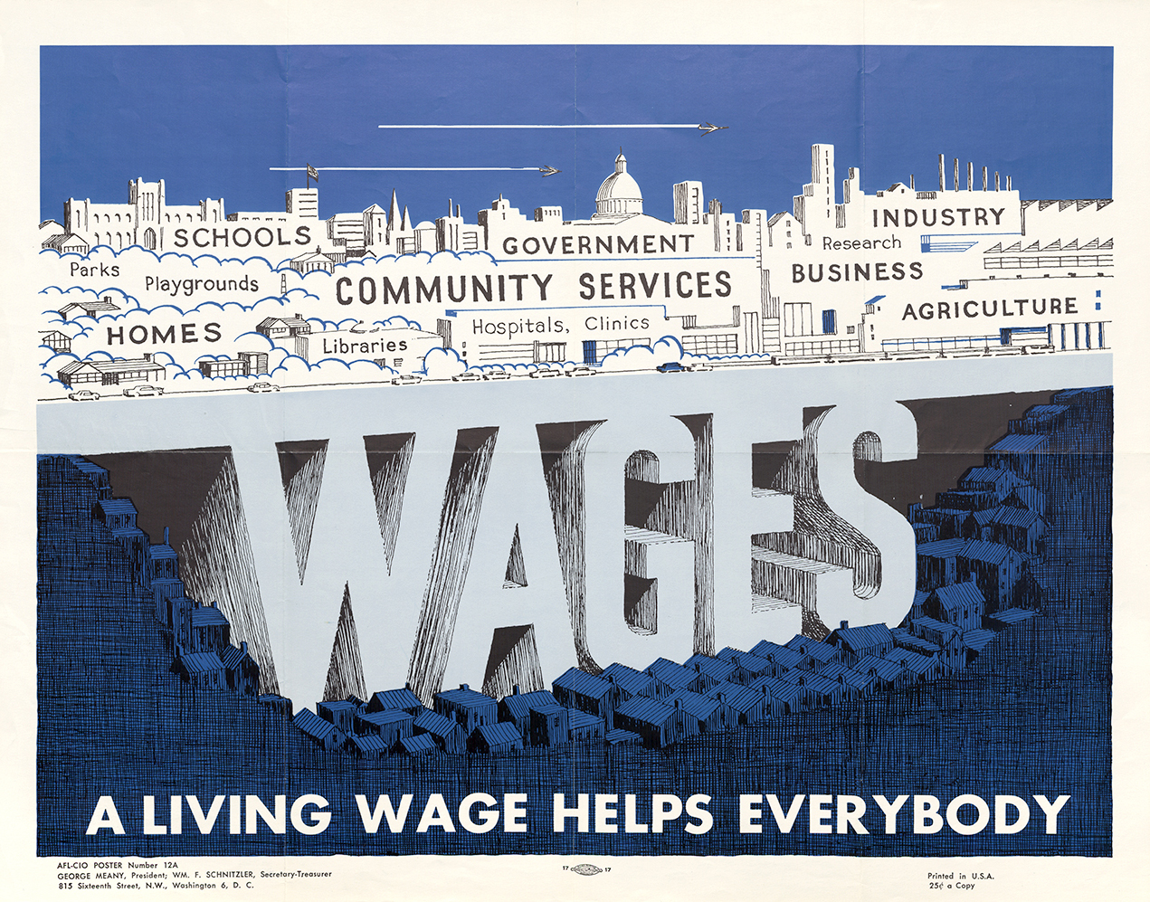
  Living Wage:
  A wage sufficient to support a family of 4 at least at the poverty line.

Slide 19
Living Wage Characteristics:
Passed through city council or via ballot initiative.
Imposes a wage floor higher than federal and state minimum wages for specific category of workers—city or county employees or employees of any company doing business with or within that city or county;
Wages often pegged to the wage level needed for a family of 3 or 4, with one full-time, year-round worker to reach the federal poverty line— some require $13.00/hour, newer campaigns have pushed for more--$15 in LA (2021) SFO (2018) Seattle (2021); Chicago $13 (2019); Fight for 15—led to the pathway to $15 for the State;
Coverage includes wages and other benefits but typically targets a specific/limited number of workers.

Slide 20
Living Wage Versus Minimum wage:
Geographical Focus:
  Local City or County versus National.
Who:
  Limited number of workers versus all U.S. workers—except some categories: ag workers,
What is Covered:
  Wages—pegged to inflation, plus other benefits; prohibit harassing workers who chose to organize, local hiring preferences and etc. versus only wages.

Slide 21
Living Wage Calculator:
http://livingwage.mit.edu/
http://www.epi.org/resources/budget/

Slide 22
Symbolic Victories?
Legislation raises wages of the lowest workers puts pressure on wage levels above these workers—reverse the race to the bottom.
Low-wage workers are highly vulnerable to employer pressure; living wage ordinances can explicitly address the right to freedom of association.
Victories raise the bar for other companies and industries creating a “wedge” for other broader campaigns.
Fairness: what are we getting for our public investment; full time workers should earn enough to be above the poverty level.
Basis for other campaigns: asking why other workers aren’t covered.

Slide 23
Builds Coalitions & Power:
Creates legal, economic, and political environments in which workers and communities can fight the power of money.
(Re)builds community by generating bonding and bridging capital.
Builds community power and democracy by implementing the policy and the need for monitoring and enforcement.
Brings hard to reach workers AND unconnected community residents into the struggle; re-frames the problem as a quality of life issue.
Coalitions became the basis for more general agreements to improve local economies: CBAs.

Slide 24
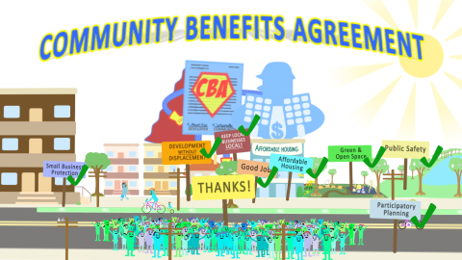

Slide 25
CBAs: What are they?
Hallmark of LAANE’s Campaign of Development with Justice:
  Negotiated deals between developers and coalitions of community organizations, that address a broad range of community needs in exchange for pubic subsidies.
  Allow community groups to have a voice in shaping development to enhance their quality of life.
  Contains safeguards to ensure that affected residents share in the benefits of major developments.
  Are legally binding.

Slide 26
Why CBAs?
Local government are playing a more central role in the push for urban economic development as the federal government slashes its contribution to urban budgets.
Responsibility for programs like workforce development and housing construction are increasingly taken up by elected officials and staff at the city and county level.
Local development is often heavily subsidized by local public dollars without resolving problems of poverty, sprawling, unplanned growth, lack of affordable housing, declining quality of life for low and middle-income families.

Slide 27
New Vision
CBAs Offer A New Vision:
To move beyond conventional thinking about community development.
  to create space for the public sector to play a more strategic role in land use planning and urban growth;
  to leverage the multibillion dollar investment in the private sector toward creating good jobs, affordable housing, and neighborhood services that improve the quality of life for all residents.
From pro-growth to community benefits—the idea that the main purpose of economic development is to bring measurable, permanent improvements to the lives of affected residents, particularly those in low-income neighborhoods—markets working for people.

Slide 28
What Happens If Development Passes Without Community Benefits attached?
Development is done exclusively without community input/voice.
Community may not like & challenge the project.
Poverty wage jobs.
Displaced community.
Environmental impacts are not mitigated.
No legally binding agreement or policy to guarantee that promises are kept.
No viable solution to poverty.

Slide 29


Growth W/O equity
Environmental decay
Poor Working Cond
Middle-class Housing Luxury Housing
Low-Wage Jobs
Displacement
Exclusion
City
LGBTQ
Unions
Local Hire
Housing
Faith-Based
Environmental Groups
Neighborhood Associations
Developers
Other Groups
Development Without a CBA

Slide 30

Designed to enhance inclusion, deliberation and equitable outcomes. Development projects supported in exchange for community benefits:
Affordable Housing
Good Jobs/Living wages/ Local Jobs / Local hiring
Environmental Mitigations
Green Space
First Source Hiring
Local and Small Business Development
Community and Neighborhood Improvements
Right to Organize
Mixed Development
Other opportunities

Slide 31
Development passes with a CBA
Residents are involved in the development process and their creative ideals are implemented in the project
Residents help shape their neighborhoods resulting in safer, healthier and thriving communities that are beneficial to all residents.
Good jobs/ living wages, environmental mitigations, affordable housing, and community enhancements are included in the development.
Residents have opportunities to move out of poverty
Residents have a real sense of ownership over the process

Slide 32
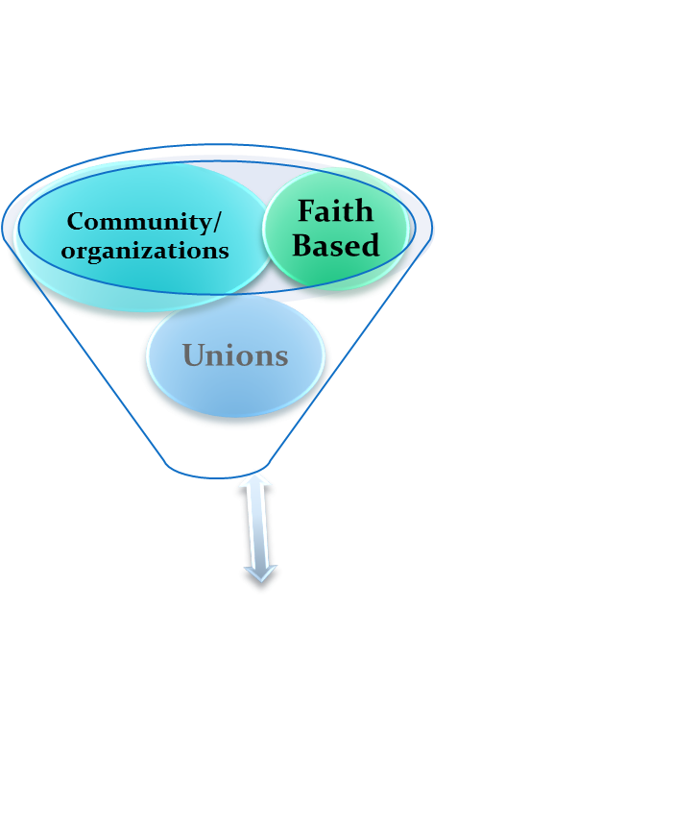




Development WITH a CBA
JOBS
HOUSING
HEALTH/SAFETY
ENVIRONMENT
NEIGHBORHOOD STABILIZATION
REGIONAL GROWTH
QUALITY OF LIFE
Developers
City/city agencies

Slide 33
Community benefits are a “win-win”
What the developer agrees to (the Benefits)
What the Community agrees to (the support of the project)
They are legally binding agreements that can be enforced by
1. Negotiation
2. Arbitration
3. Litigation

Slide 34
Living-wage and CBA campaigns are innovative in three Respects.
First, they target communities thereby establishing a basis for broader appeals (such as questioning jobs-at-any-cost strategies).
Second, forge broad-based alliances built on multi-issue campaigns—differs from previous actions where groups tended to focus on their own concerns and consequently acting alone on specific issues or in smaller coalitions.
Third: are community efforts that focus on the community rather than industry; builds community networks and coalitions that can serve as the basis for other community campaigns to combat the individualizing, anti-democratic and inequality effects of neoliberal globalization.

Slide 35
Some Weaknesses:
CBAs:
  Enforcement: Difficulty in Enforcing, in cases where the city is not involved;
  Participation: Community can be tokenized;
  Legitimacy: What is the community & who represents it?
Living Wage
  Poverty: Living wage rates are often less than necessary to fundamentally reduce poverty;
  Job Loss: Often the lowest skilled are laid-off to justify the higher wage levels;
  Scaling-up: Too much focus on the local takes energy away from national-level efforts at reform. To address poverty there needs to be a scaling-up from the local to the national.

Slide 36
Lessons of LA:
Democracy: the Core Issues and Movements are about people: Grass-roots organizing and multi-racial, multi-generational & multi-sector coalition building; Building spaces of inclusion and participation.
Empowerment: Learn by doing (& self-reflection); leadership development and community empowerment through building independent community political organizations;
Evidence-Based: Solutions driven by evidence and an understanding of power distribution;
Coalitions: all stakeholders included: the community, public officials, developers—e.g., Valley Interfaith;
Linkages: An awareness of that local communities are embedded within a broader economy—there are many struggles;
Punch Line: There are no quick fixes: base building & coalition building; continual engagement of the public; multi-tracked strategies and continual monitoring & accountability.

